Slide 1
Synchronization Examples Lesson 2 Synchronization in kernel
David Liu
Fall 2021

Slide 2
OS Supports Synchronization
Windows Support
Linux Support

Slide 3
Kernel Synchronization - Windows
Uses interrupt masks to protect access to global resources on uniprocessor systems
Uses spinlocks on multiprocessor systems
Spinlocking-thread will never be preempted

Slide 4

Process State Diagram

Slide 5
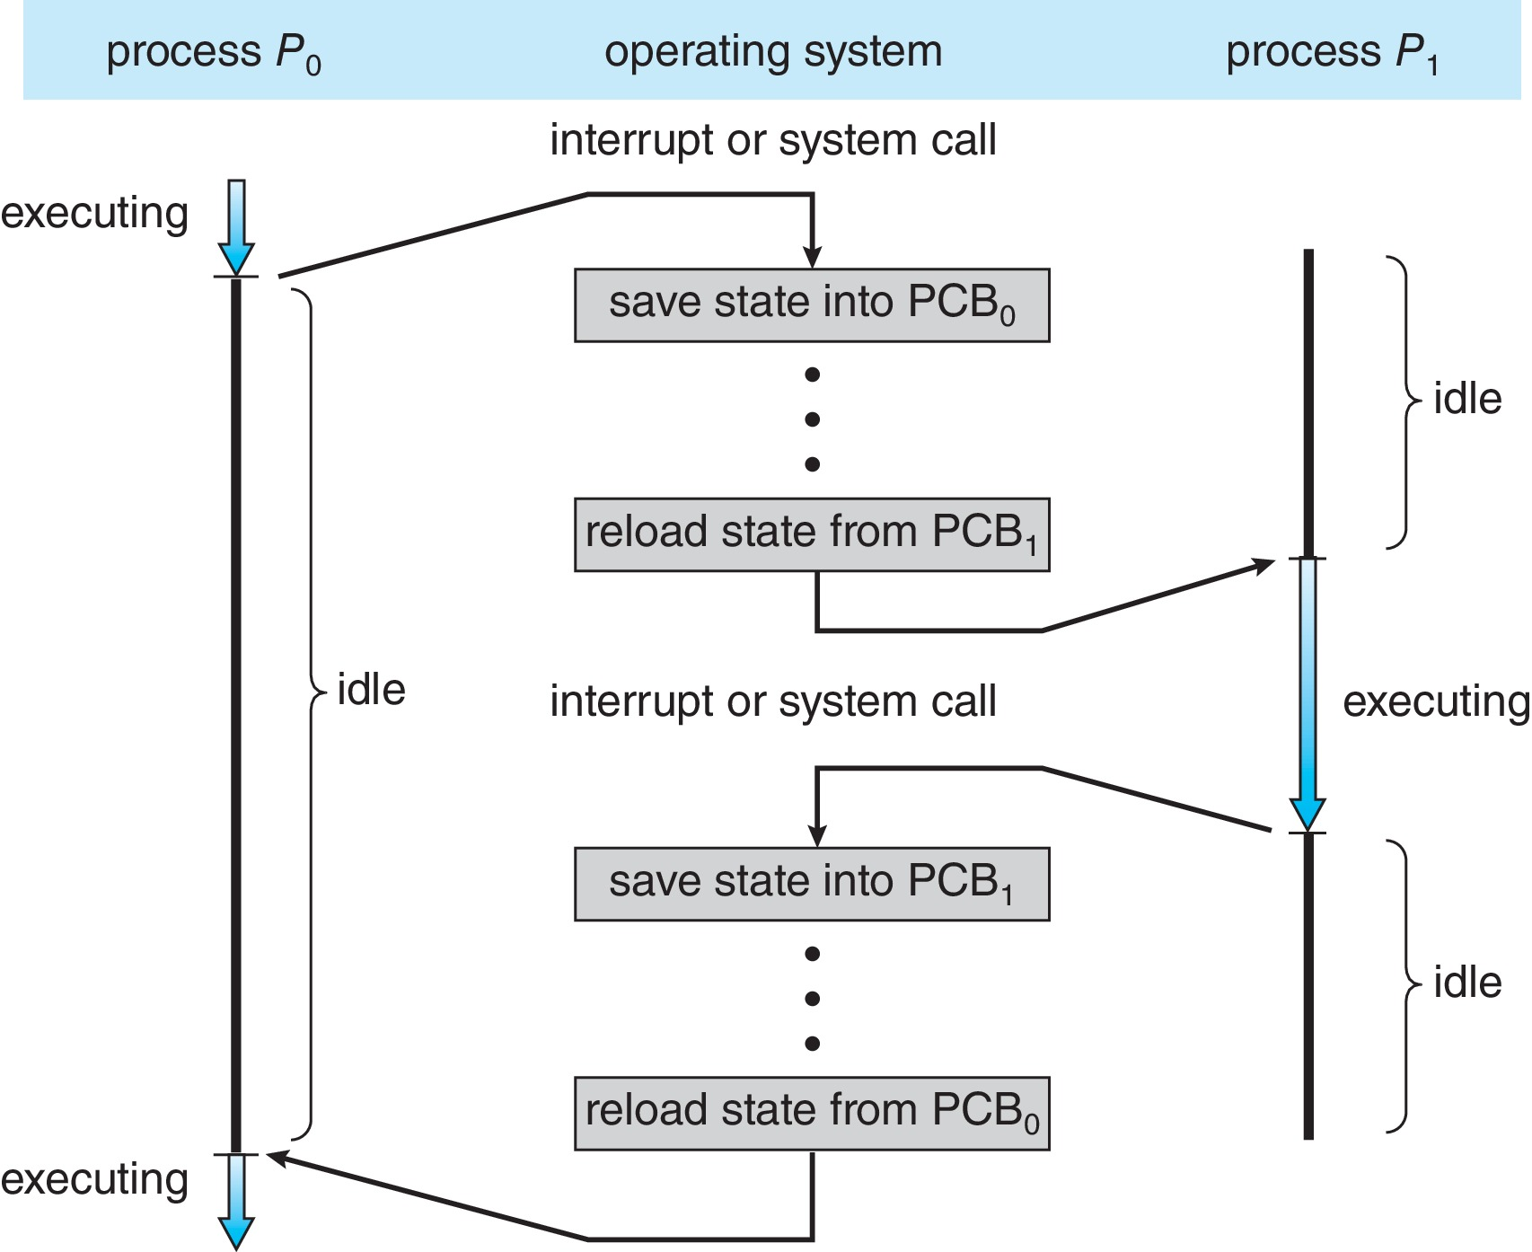
Context Switch
CPU switches from one process to another

Slide 6
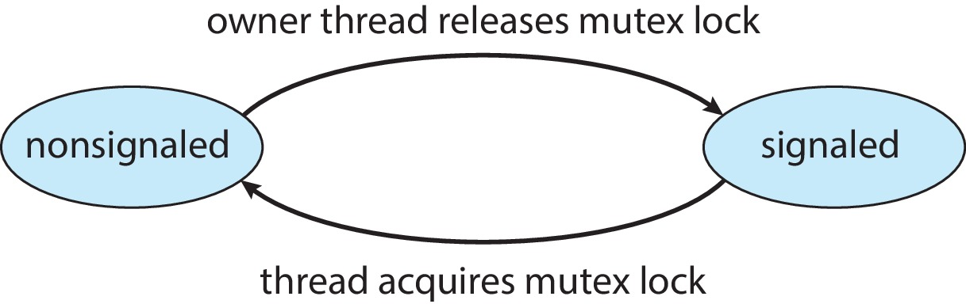
User Space Synchronization - Windows
User-space dispatcher objects
Mutex Objects
Semaphore Objects
Event Objects
An event acts much like a condition variable
However, all waiting threads will be selected by kernel
Timer Objects notify one or more thread when time expired
signaled-state (object available) or non-signaled state (thread will block)

Slide 7
User Space Synchronization - Windows
Critical-Section Objects
User-mode mutex
Multiprocessor system
Spinlock first
If spinlock is too long, allocates a kernel mutex and yields CPU

Slide 8
Linux Synchronization
Atomic integers
Mutex (with sleep state)
Spinlocks (reader-writer versions of both)
Semaphores (reader-writer versions of both)
On single-processing core system, spinlocks replaced by enabling and disabling kernel preemption

